Slide 1

KS3 Mathematics
D3 Representing and interpreting data
Notes:
The aim of this unit is to teach pupils to:
Construct graphs and diagrams to represent data, on paper and using ICT.
Interpret diagrams and graphs, and draw inferences.
Compare two simple distributions using the range, mode, mean or median.
Material in this unit is linked the Framework’s supplement of examples pp262 –275.

Slide 2


Contents
D3 Representing and interpreting data
D3.1 Bar charts
D3.2 Pie charts
D3.3 Frequency diagrams
D3.4 Line graphs
D3.5 Scatter graphs
D3.6 Stem and Leaf Plot

Slide 3
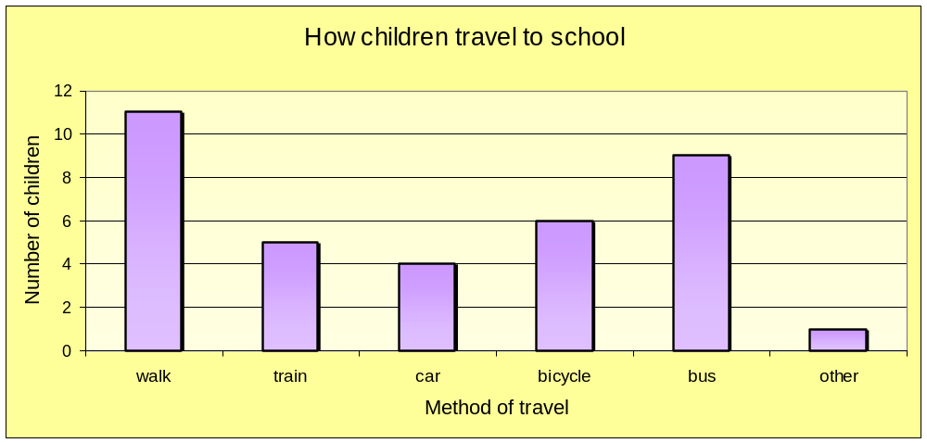
Bar charts for categorical data
Bar charts can be used to display categorical or non-numerical data.
For example, this bar graph shows how a group of children travel to school.
Notes:
Draw pupils’ attention to the gaps between the bars. The height of each bar represents the frequency for that category.
Ask questions based on this data, For example,
What is the modal method of transport?
How many of the pupils questioned travelled by train?
How many children took part in this survey?

Slide 4
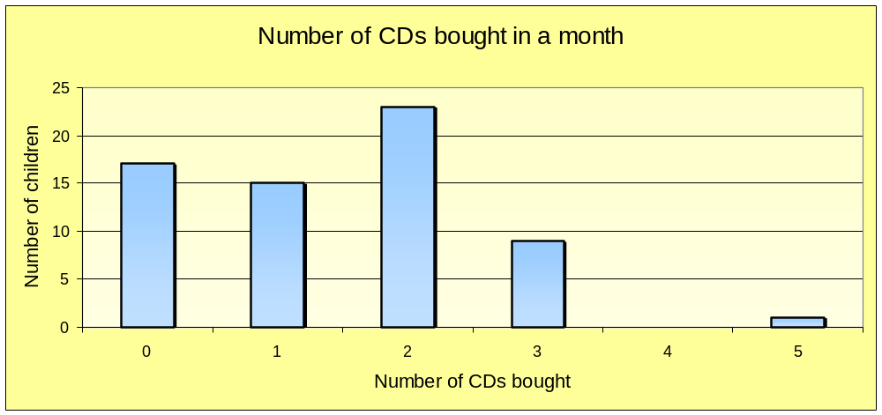
Bar charts for discrete data
Bar charts can be used to display discrete numerical data.
For example, this bar graph shows the number of CDs bought by a group of children in a given month.
Notes:
Remind pupils that discrete data is numerical data that can only take certain values. For example, we couldn’t have 2.3 CDs.

Slide 5
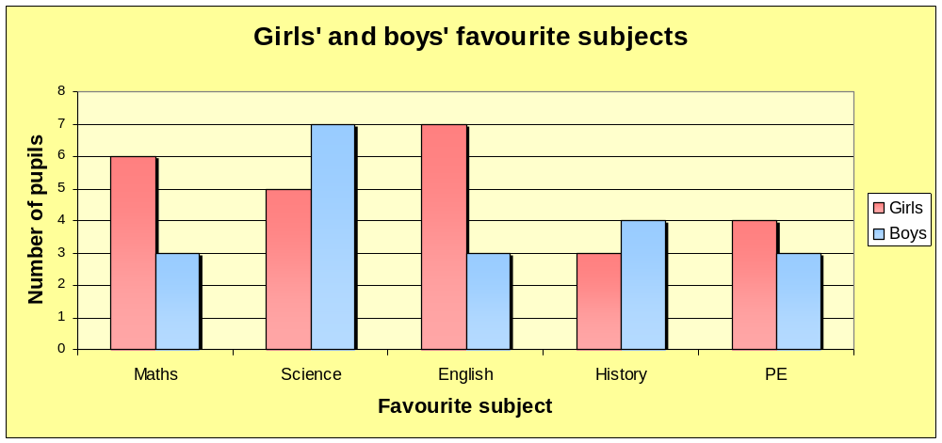
Bar charts for two sets of data
Two or more sets of data can be shown on a bar chart.
For example, this bar chart shows favourite subjects for a group of boys and girls.
Notes:
Stress that we must include a key when more than one type of data is displayed in the same chart.
Ask,
What subject did most girls like the best?
What subject did most boys like the best?
Is it possible to tell if an equal number of boys and girls took part in the survey?

Slide 6
Drawing bar charts
When drawing bar chart remember:
Give the bar chart a title.
Use equal intervals on the axes.
Label both the axes.
Leave a gap between each bar.

Slide 7

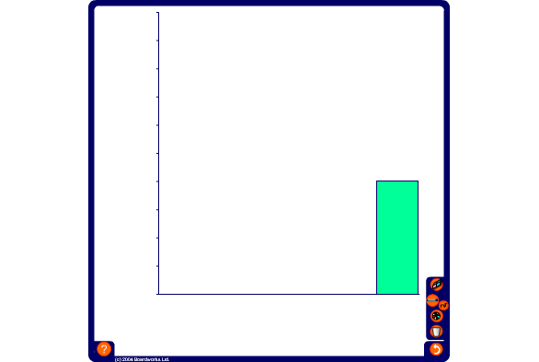
Drawing bar charts
Use the data in the frequency table to complete a bar chart showing the the number of children absent from school from each year group on a particular day.
Year
Number of absences
7
74
8
53
9
32
10
11
11
10
Notes:
Start by deciding on a suitable scale for the vertical axis. For example use each division to represent two pupils. Number this axis using the pen tool. Ask volunteers to drag each bar to the required frequency.
Copy this slide and modify the table to produce more examples if required.

Slide 8
Contents
D3 Representing and interpreting data
D3.1 Bar charts
D3.2 Pie charts
D3.3 Frequency diagrams
D3.4 Line graphs
D3.5 Scatter graphs
D3.6 Stem and Leaf Plot

Slide 9
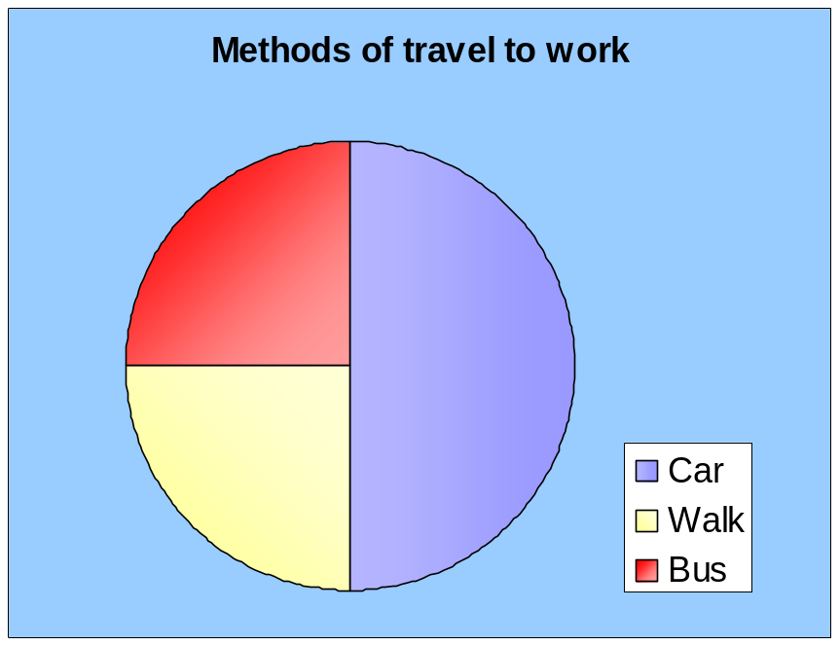
Pie charts
A pie chart is a circle divided up into sectors which are
representative of the data.
In a pie chart, each category is shown as a fraction of the circle.
For example, in a survey half the people asked drove to work, a quarter walked and a quarter went by bus.
Notes:
In a bar chart, the size of each category is compared with each of the others. In a pie chart, each category is compared with the whole.
Point out that if the sectors are not labelled we must include a key.

Slide 10
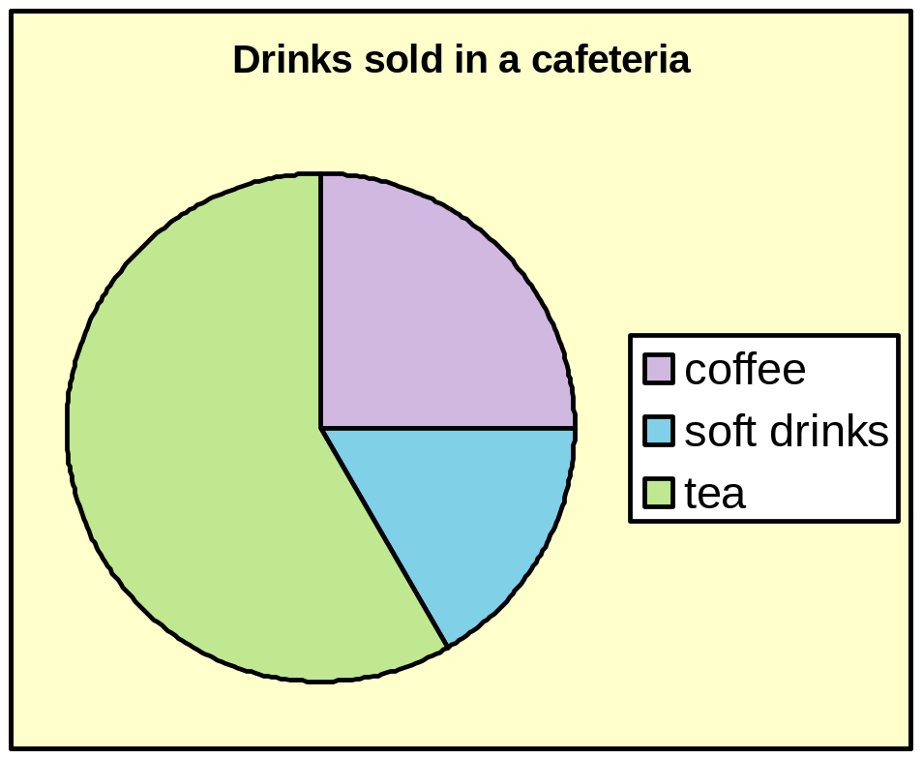
Pie charts
This pie chart shows the distribution of drinks sold in a cafeteria on a particular day.
Altogether 300 drinks were sold.
Estimate the number of each type of drink sold.
Coffee:
75
Soft drinks:
50
Tea:
175
Notes:
Ask pupils to estimate the fraction shown by each sector.
The angle of the sector representing coffee is a right angle. It must therefore represent a quarter of the pie chart. A quarter of 300 is 75.
The angle of the sector representing soft drinks looks like a 60º angle or a sixth of the pie chart. A sixth of 300 is 50.
The rest of the drinks must be tea. So, using the answers we have already, 300 – 75 – 50 = 175.
Explain that if we had a protractor we could find the actual angles and by writing these as fractions of 360º we could calculate the required proportions.

Slide 11
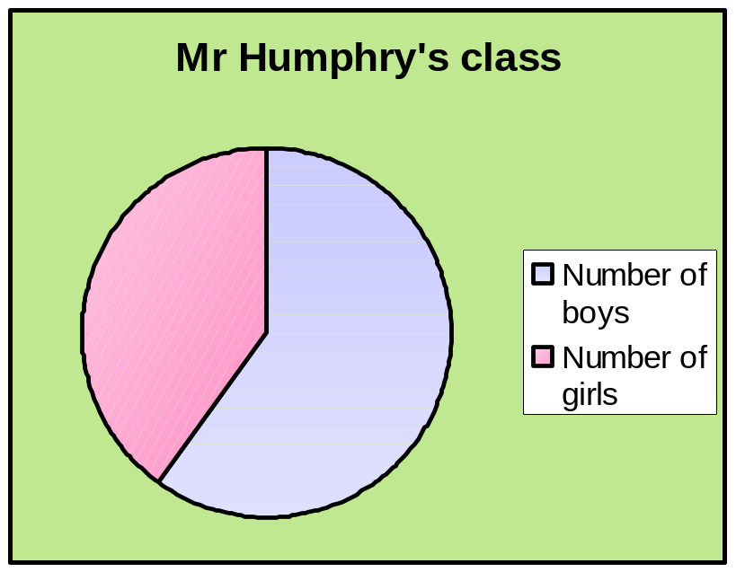
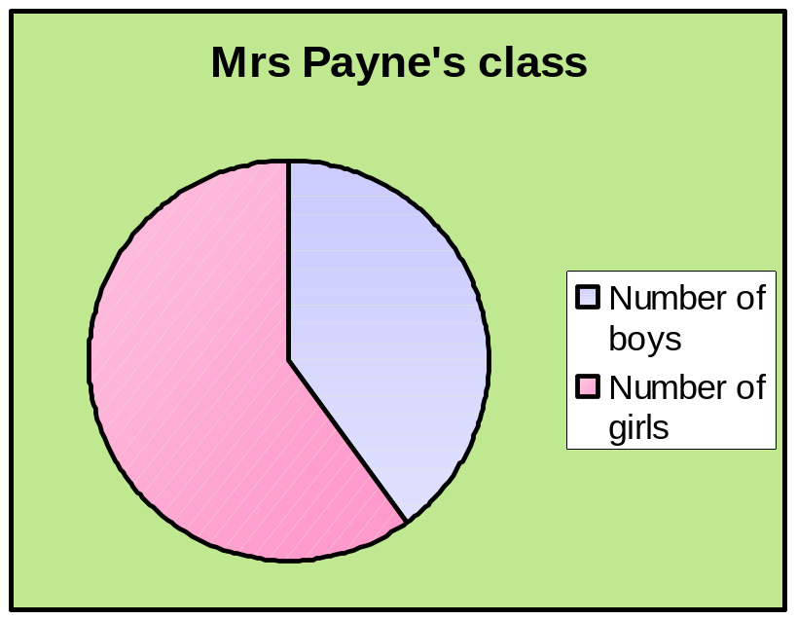
Pie charts
These two pie charts compare the proportions of boys and girls in two classes.
Dawn says, “There are more girls in Mrs Payne’s class than in Mr Humphry’s class.” Is she right?
Notes:
Stress that pie charts compare proportions and not actual amounts.
The pie charts in the example show that ²/₅ of the pupils in Mr Humphry’s class are girls and ³/₅ of the pupils in Mrs Payne's class are girls. We can conclude from this that a higher proportion of the pupils in Mrs Payne’s class are girls.
However, unless we are told otherwise we cannot assume that there are the same number of pupils in each class. Suppose, for example that there are 30 pupils in Mr Humphry’s class and 15 pupils in Mrs Payne’s class.
²/₅ of 30 is 12, so that would give us 12 girls in Mr Humphry’s class.
³/₅ of 15 is 9, so that would give us 9 girls in Mrs Payne’s class.
Conclude that we cannot make statement about the actual amounts in a pie chart unless we are told how many the pie chart represents.

Slide 12
Drawing pie charts
Use the data in the frequency table to complete the pie chart showing the favourite colours of a sample of people.
Favourite colour
No of people
Favourite colour
No of people
Favourite colour
No of people
Red
10
Red
10
Red
10/36*100=27.8%
Yellow
3
Yellow
3
Yellow
3/36*100=8.3%
Blue
14
Blue
14
Blue
14/36*100=38.9%
Green
5
Green
5
Green
5/36*100=13.9%
Purple
4
Purple
4
Purple
4/36*100=11.1%
Total
36
Total
100%
Divide each value by the total and multiply by 100 to get a percent:
Notes:
Start by working out the total number of people to be represented by the data.
There are 36 people altogether so conclude that it would be better to use the total number of degrees representing each person (because 36 divides easily into 360º) to calculate the angle for each sector.
360º ÷ 36 = 10º some each person is represented by a 10º angle.
The angle required to represent the number of people who prefer red is therefore 10 × 10º = 100º.
Ask a volunteer to show this angle on one of the sectors in the pie chart and use the pen tool to label it red.
Continue until the pie chart is complete.

Slide 13
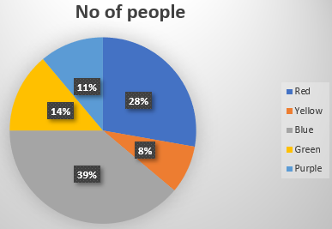
Drawing pie charts
Find degrees for each “pie sector”
The central angle of each component = (Value of each component/sum of values of all the components)✕360°
Favourite colour
No of people
Red
10/36*360º=100º
Yellow
3/36*360º=30º
Blue
14/36*360º=140º
Green
5/36*360º=50º
Purple
4/36*360º=40º
Total
360º
Notes:
Start by working out the total number of people to be represented by the data.
There are 36 people altogether so conclude that it would be better to use the total number of degrees representing each person (because 36 divides easily into 360º) to calculate the angle for each sector.
360º ÷ 36 = 10º some each person is represented by a 10º angle.
The angle required to represent the number of people who prefer red is therefore 10 × 10º = 100º.
Ask a volunteer to show this angle on one of the sectors in the pie chart and use the pen tool to label it red.
Continue until the pie chart is complete.

Slide 14
Contents
D3 Representing and interpreting data
D3.1 Bar charts
D3.2 Pie charts
D3.3 Frequency diagrams
D3.4 Line graphs
D3.5 Scatter graphs
D3.6 Stem and Leaf Plot

Slide 15
Frequency diagrams
Frequency diagrams are used to display grouped continuous data.
For example, this frequency diagram shows the distribution of heights in a group of Year 8 pupils:
Heights of Year 8 pupils
35
30
25
20
The divisions between the bars are labelled.
Frequency
15
10
5
0
140
145
150
155
160
165
170
175
Height (cm)
Notes:
Point out that a frequency diagram is very similar to a bar chart except that the bars touch each other and the divisions between the bars are labelled.
Ask pupils to give the modal class interval for the data on the board.
Discuss the type of data that would be shown in a frequency diagram. For example, time taken to run a race, foot length, weights etc. In other words, anything that is measured.

Slide 16
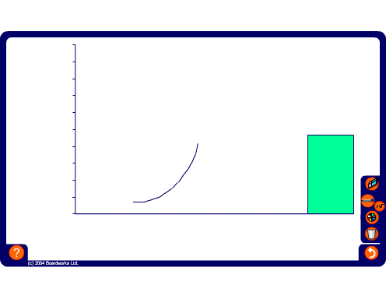
Drawing frequency diagrams
Use the data in the frequency table to complete the frequency diagram showing the time pupils spent watching TV on a particular evening:
Time spent (hours)
Number of people
0 ≤ h < 1
4
1 ≤ h < 2
6
2 ≤ h < 3
8
3 ≤ h < 4
5
4 ≤ h < 5
3
h ≤ 5
1
Notes:
Start by discussing how to number the vertical axis. Use the pen tool to do this.
Drag the first bar to the appropriate height. Ask a volunteer to drag the next bar and continue until the bars are complete.
Finally, ask a volunteer to use the pen tool to show how the horizontal axis should be numbered.
Copy this slide and modify the table to produce more examples if required.

Slide 17
Contents
D3 Representing and interpreting data
D3.1 Bar charts
D3.2 Pie charts
D3.3 Frequency diagrams
D3.4 Line graphs
D3.5 Scatter graphs
D3.6 Stem and Leaf Plot

Slide 18
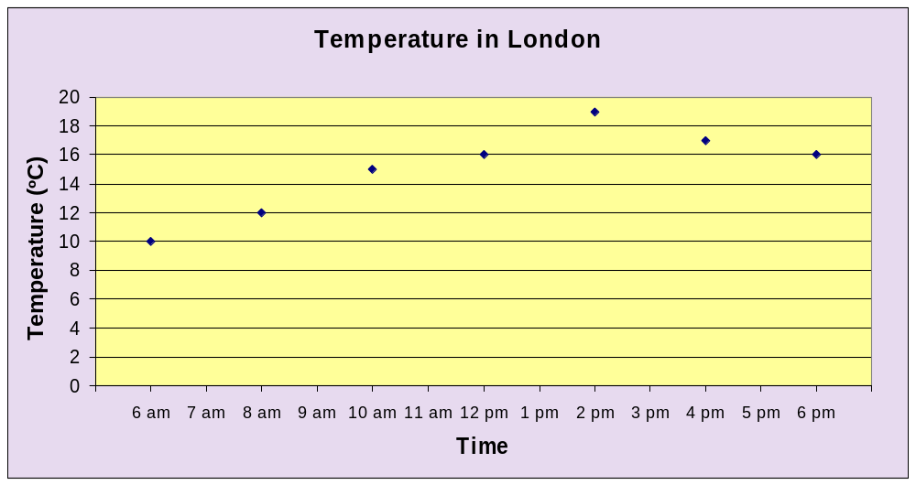
Line graphs
Line graphs are most often used to show trends over time.
For example, this line graph shows the temperature in London, in ºC, over a 12-hour period.
Notes:
Explain that in a line graph points are plotted and then joined together using a ruler. Ask pupils questions based on the line graph shown. For example,
What is the temperature at 10 am?
What is the range of the recorded temperatures over the 12-hour period?
Can we use the graph to work out the exact temperature at 9 am?
Can we use the graph to work out the maximum temperature during the day?
We can only work out the maximum recorded temperature. Since the temperature was only recorded every two hours, the maximum temperature may have been reached before or after 2 pm.
Stress that any value that is taken from the line joining two points is only an estimate of the value at that point.

Slide 19
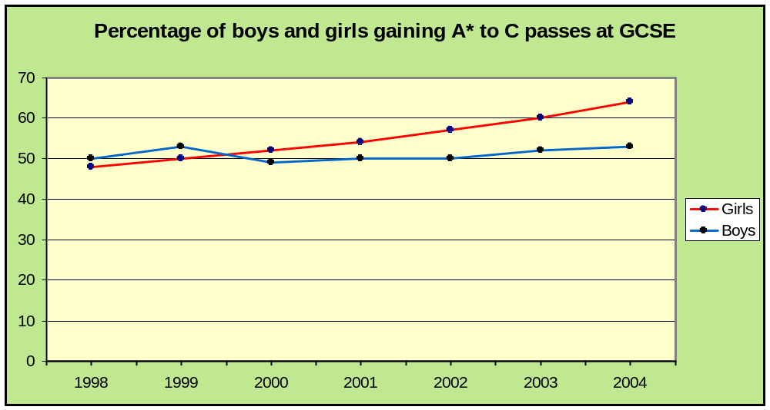
Line graphs
This line graph compares the percentage of boys and girls gaining A* to C passes at GCSE in a particular school.
What trends are shown by this graph?
Notes:
Stress that when two sets of data are shown on a graph we must label the lines or provide a key.

Slide 20
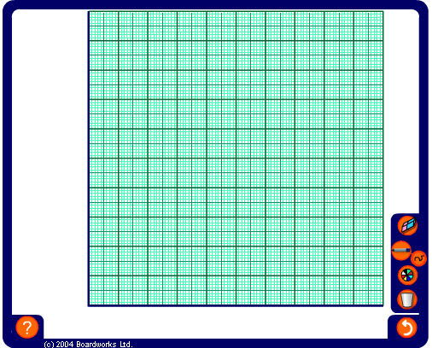
Drawing line graphs
This data shows the weight of a child taken every birthday.
Plot the points on the graph and join them with straight lines.
Age (years)
Weight (kg)
1
9.5
2
12.0
3
14.2
4
16.3
5
18.4
Notes:
Start by numbering the axes.
Ask volunteers to plot the points and join them. Ask if it would make sense to join the first point to the origin. Conclude that if we did this we would by saying that when the child was 0 (newborn) it had no weight. We therefore start the line from the point (1,10) because we have not been given the child’s birth weight.
Ask pupils if the intermediate points have any significance. Conclude that since the measurements were taken on the child’s birthday, the points are one year apart. This mean that we can predict the child’s age at any any point on the line.
For example, ask pupils to use the graph to tell you the approximate weight of the child at the age of 3½. Also, ask them to estimate the child age when they weighed 13kg.
Copy this slide and modify the table to produce more examples if required.

Slide 21
Contents
D3 Representing and interpreting data
D3.1 Bar charts
D3.2 Pie charts
D3.3 Frequency diagrams
D3.4 Line graphs
D3.5 Scatter graphs
D3.6 Stem and Leaf Plot

Slide 22
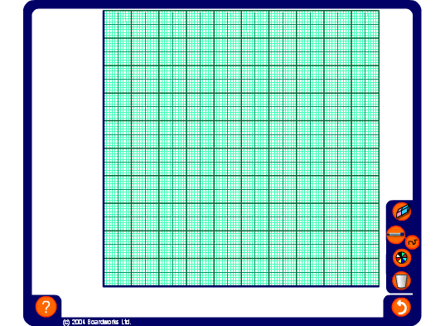
Scatter graphs
We can use scatter graphs to find out if there is any relationship or correlation between two set of data.
Handspan (cm)
18
16
20
15
16
21
19
17
20
18
Foot length (cm)
24
21
28
20
22
30
25
22
27
23
Notes:
Explain that the table shows the handspan and foot length of ten children and that we can plot the handspan against the foot length for each child.
Start by deciding on an appropriate scale for the axes by considering the range for each measurement.
Number the axes using the pen tool and ask volunteers to come to the board and plot the points.
When the point have been plotted ask pupils if we can deduce anything from this graph.
Suggest that we might get a better overall picture if there was more data.

Slide 23
Scatter graphs and correlation
We can use scatter graphs to find out if there is any relationship or correlation between two sets of data.
For example,
Do tall people weigh more than small people?
If there is more rain, will it be colder?
If you revise longer, will you get better marks?
Do second-hand car get cheaper with age?
Is more electricity used in cold weather?
Are people with big heads better at maths?
Notes:
For each example, discuss the data that would have to be collected and what you would expect the result to be.

Slide 24
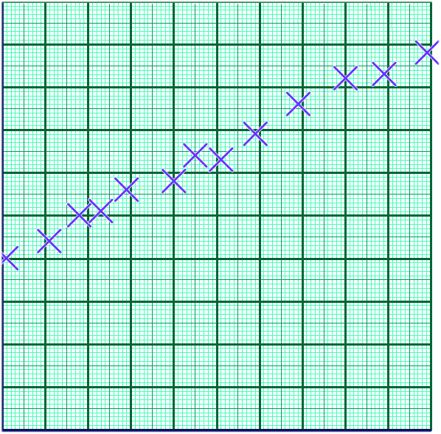
Scatter graphs and correlation
When one variable increases as the other variable increases, we have a positive correlation.
For example, this scatter graph shows that there is a strong positive correlation between the length of a spring and the mass of an object attached to it.
Length of spring (cm)
The points lie close to an upward sloping line.
This is the line of best fit.
Mass attached to spring (g)
Notes:
Establish that this graph shows that the more mass is attached to the spring, the longer it stretches.
You may like to point out that if we had a perfect positive correlation, all of the points would lie on the same straight line. It this case there would be a mathematical formula linking the two variables. The length of a spring and the mass attached to it may have a perfect correlation. However, other factors such as errors in measurements, mean that when we conduct an experiment the points do not usually lie on the same straight line.
Link:
A6 Real-life graphs – plotting graphs

Slide 25
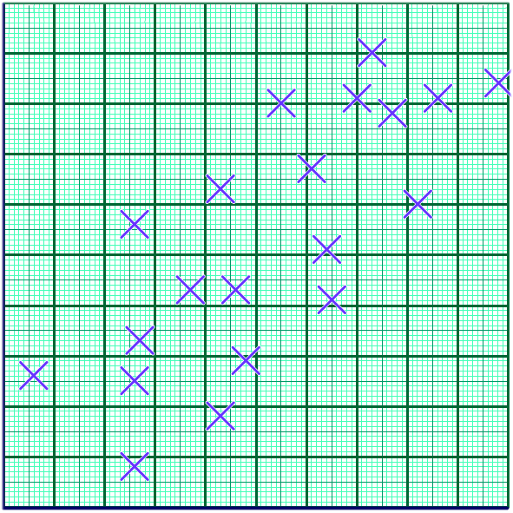
Scatter graphs and correlation
Sometimes the points in the graph are more scattered. We can still see a trend upwards.
This scatter graph shows that there is a weak positive correlation between scores in a maths test and scores in a science test.
Science score
The points are scattered above and below a line of best fit.
Maths score
Notes:
Establish that this graph shows that, in general, the better a pupil is at maths, the better they are at science.

Slide 26
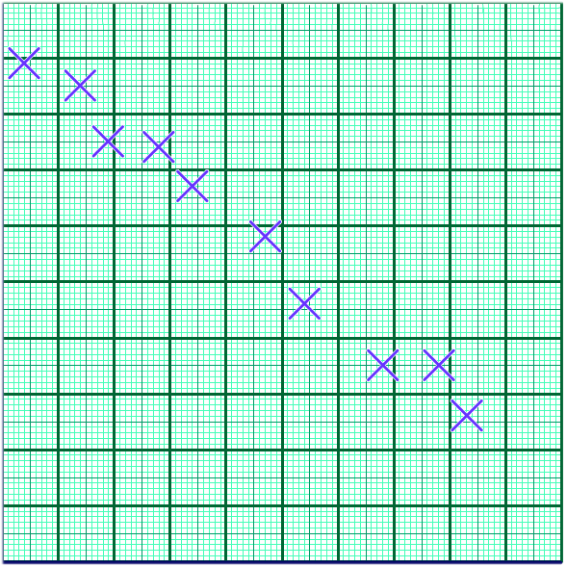
Scatter graphs and correlation
When one variable decreases as the other variable increases, we have a negative correlation.
For example, this scatter graph shows that there is a strong negative correlation between rainfall and hours of sunshine.
Temperature(°C)
The points lie close to a downward sloping line of best fit.
Rainfall (mm)
Notes:
Establish that this graph shows that the more rain there is, the colder it is. In other words, the lower the temperature the greater the rainfall.

Slide 27
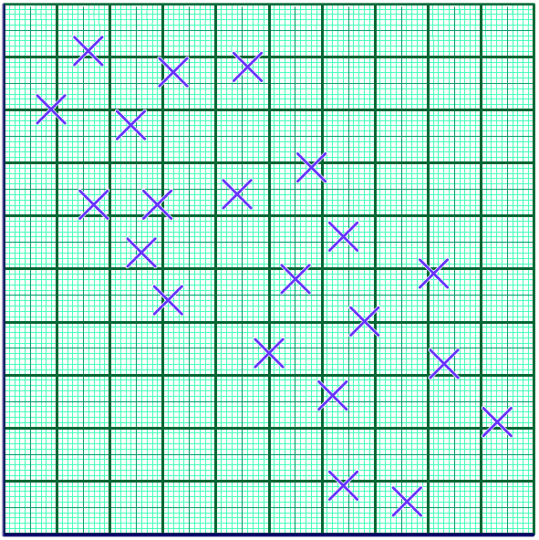
Scatter graphs and correlation
Sometimes the points in the graph are more scattered.
We can still see a trend downwards.
For example, this scatter graph shows that there is a weak negative correlation between the temperature and the amount of electricity a family used.
Outdoor temperature (ºC)
Electricity used (kWh)
Notes:
Establish that this graph shows that the the colder it is, the more electricity the family uses.
Ask pupils to explain why the family might use more electricity on colder days.

Slide 28
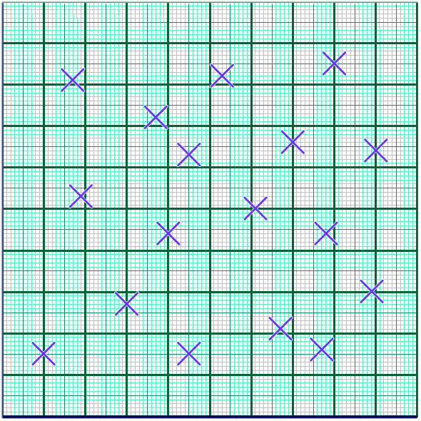
Scatter graphs and correlation
Sometimes a scatter graph shows that there is no correlation between two variables.
For example, this scatter graph shows that there is a no correlation between a person’s age and the number of hours they work a week.
Number of hours worked
The points are randomly distributed.
Age (years)
Notes:
Ask pupils to show a point that could represent a younger person who works long hours. What about a point that could represent an older person who works for only a few hours? A younger person who works for only a few hours? An older person who works long hours?

Slide 29
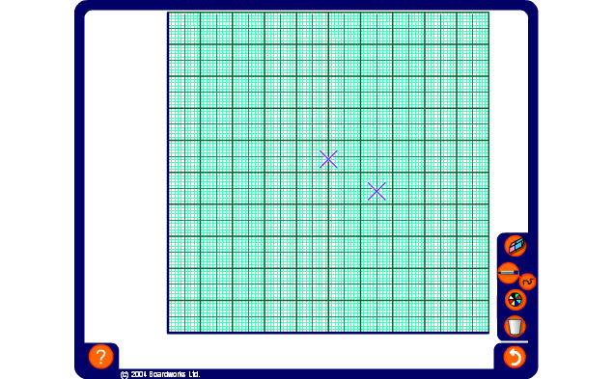
Plotting scatter graphs
This table shows the temperature on 10 days and the number of ice creams a shop sold. Plot the scatter graph and find the type of relation between temperature and the number of ice creams a shop sold.
Temperature (°C)
14
16
20
19
23
21
25
22
18
18
Ice creams sold
10
14
20
22
19
22
30
15
16
19
Notes:
Ask pupils to predict whether or not there will be any correlation shown by the data.
Decide on an appropriate scale for the axes by considering the range for each measurement and number the axes using the pen tool.
Ask volunteers to come to the board and plot the points from the table.
Ask volunteers to plot the points on the diagram.
Decide if there is any correlation between the values and use the pen tool (set to draw straight lines) to draw a line of best fit.

Slide 30

Plotting scatter graphs
We can use scatter graphs to find out if there is any relationship or correlation between two set of data.
Hours watching TV
2
4
3.5
2
1.5
2.5
3
5
1
0.5
Hours doing homework
2.5
0.5
0.5
2
3
2
1
0
2
3
Notes:
Ask pupils to predict whether or not there will be any correlation shown by the data.
Decide on an appropriate scale for the axes by considering the range for each measurement and number the axes using the pen tool.
Ask volunteers to come to the board and plot the points from the table.
Ask volunteers to plot the points on the diagram.
Decide if there is any correlation between the values.
Use the pen tool (set to draw straight lines) to draw a line of best fit, if appropriate.
Copy this slide and modify the table to produce more examples if required.

Slide 31
Contents
D3 Representing and interpreting data
D3.1 Bar charts
D3.2 Pie charts
D3.3 Frequency diagrams
D3.4 Line graphs
D3.5 Scatter graphs
D3.6 Stem and Leaf Plot

Slide 32
Contents
D3 Representing and interpreting data
D3.1 Bar charts
D3.2 Pie charts
D3.3 Frequency diagrams
D3.4 Line graphs
D3.5 Scatter graphs
D3.6 Stem and Leaf Plot

Slide 33
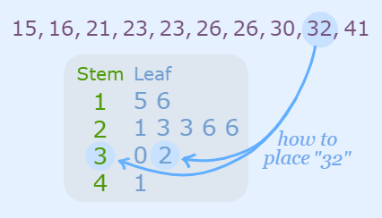
Stem and Leaf Plot
A stem and leaf plot is used to organize data as they are collected. A stem and leaf plot looks something like a bar graph. Each number in the data is broken down into a stem and a leaf, thus the name. The stem of the number includes all but the last digit. The leaf of the number will always be a single digit
It is a way to arrange and represent data so that it is simple to see how frequently various data values occur. It is a plot that displays ordered numerical data.
Notes:
Ask pupils to predict whether or not there will be any correlation shown by the data.
Decide on an appropriate scale for the axes by considering the range for each measurement and number the axes using the pen tool.
Ask volunteers to come to the board and plot the points from the table.
Ask volunteers to plot the points on the diagram.
Decide if there is any correlation between the values.
Use the pen tool (set to draw straight lines) to draw a line of best fit, if appropriate.
Copy this slide and modify the table to produce more examples if required.

Slide 34
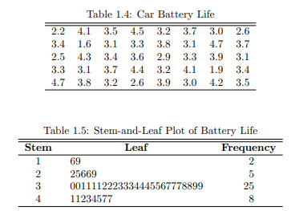
Stem and Leaf Plot
Notes:
Ask pupils to predict whether or not there will be any correlation shown by the data.
Decide on an appropriate scale for the axes by considering the range for each measurement and number the axes using the pen tool.
Ask volunteers to come to the board and plot the points from the table.
Ask volunteers to plot the points on the diagram.
Decide if there is any correlation between the values.
Use the pen tool (set to draw straight lines) to draw a line of best fit, if appropriate.
Copy this slide and modify the table to produce more examples if required.

Slide 35
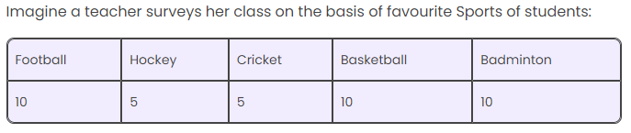
Practice Questions
Construct appropriate graphs for the following data

Slide 36
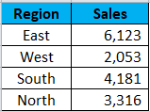
Practice Questions
Construct appropriate graphs for the following data
Sales data for 4 regions: East, West, South, and North.

Slide 37
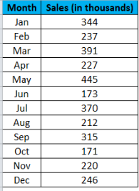
Practice Questions
Construct appropriate graphs for the following data
Monthly Sales of a company

Slide 38
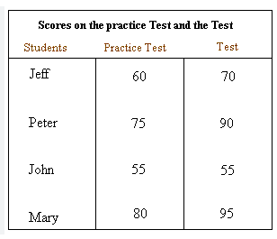
Practice Questions
Construct appropriate graphs for the following data

Slide 39
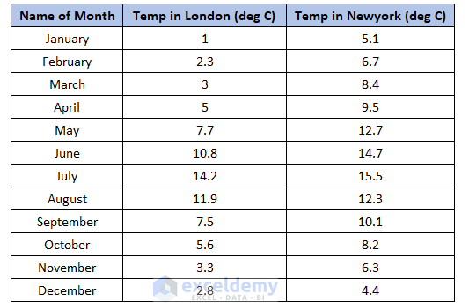
Practice Questions
Construct appropriate graphs for the following data

Slide 40
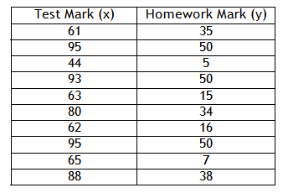
Practice Questions
Construct appropriate graphs for the following data

Slide 41
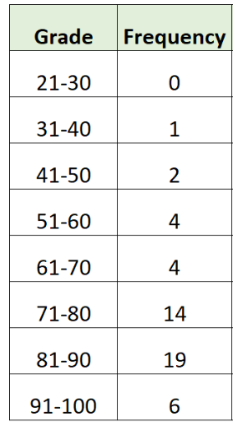
Practice Questions
Construct appropriate graphs for the following data

Slide 42
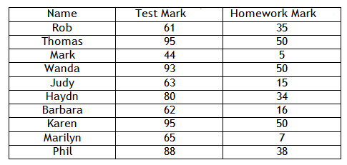
Practice Questions
Construct appropriate graphs for the following data

Slide 43

Practice Questions
Construct appropriate graphs for the following data

